Slide 1



Business Plan & Business Models Canvas
BTMW 4012: TECHNOLOGY ENTREPRENEURSHIP
LECTURE 3

Slide 2

What is a Business Plan
A business plan is the written document for a proposed business project that serve:
•as a blueprint
•as a guide
Information gathered regarding the project is used in the Business Plan to predict viability, forecast success and propose strategies for the project

Slide 3



The Business Plan:
Three Essential Functions
Guiding the company by charting its future course and defining its strategy for following it.
Attracting lenders and investors who will provide needed capital.
Demonstrating that the entrepreneur understands the business venture and what will make it succeed.

Slide 4

To allow the entrepreneur to view and evaluate the proposed business venture in an objective, critical and practical manner.
To analyze and evaluate the viability of a proposed venture
To convince relevant parties of the investment potential of the project
As a guideline for managing the business
To allocate business resources effectively
Purpose of Preparing a Business Plan

Slide 5




Who Needs a Business Plan ?
The Entrepreneur
Investors
Financial Institutions
Suppliers
Customers
Company Staff

Slide 6


Business Plan Format
Cover letter
Cover page
-Title of the Business Plan
-Name of the business and business address
-Name of the writer/s
-Date of submission
Table of contents
Executive summary
The main body of the business plan
Appendices
-Suppliers’ quotation
-Agreement letter
-Letter of references
-Research findings

Slide 7

Body of the Business Plan
1. Introduction
◦Name of the company
◦Nature of business
◦Industry profile
◦Location of the business
◦Date of business commencement
◦Factors in selecting the proposed business
◦Future prospects of the business
2. Purpose
◦ must be stated clear, concise, and coherent manner

Slide 8

Body of the Business Plan
3. Company background
◦Name of the company
◦Business address
◦Correspondence address
◦Telephone number
◦Form of business
◦Main activity/activities
◦Date of registration
◦Registration number
◦Name of bank
◦Bank account number

Slide 9

Body of the Business Plan
4. Owner or partners background
◦Name of the owner/partners
◦Identity card number
◦Permanent address
◦Correspondence address
◦Telephone number
◦Date of birth
◦Age & Marital status
◦Academic qualifications
◦Courses attended
◦Skills & Experience
◦Present occupation
◦Previous business experience

Slide 10

Body of the Business Plan
5. Location of the business
◦The physical location of the project
◦Building
◦Basic amenities
6. Administrative Plan
◦Introduction to the organization
◦Organization chart
◦Manpower planning
◦Schedule of tasks and responsibilities
◦Schedule of remuneration
◦List of office equipment
◦Administrative budget

Slide 11

Body of the Business Plan
7. Marketing Plan
◦Product or service description
◦Target market
◦Market size
◦Competition
◦Market share
◦Sales forecast
◦Marketing strategy
◦Marketing budget
Notes:
Buktikan peluang nk menguasai pasaran
Iklankan kat mana – Titktok, ads

Slide 12

Body of the Business Plan
8. Operation plan
◦Process flow chart
◦Production schedule
◦Material requirements
◦Manpower requirements
◦Machine and equipment
◦Operations layout plan
◦Location
◦Operation overheads
◦Operation budget
Notes:
Membabitkan teknologi
Detak loan sesuai (cth: RM15000, van, etc etc)

Slide 13

Body of the Business Plan
9. Financial plan
◦Project implementation cost
◦Sources of funds
◦Proformacashflow
◦Proforma profit and loss
◦Proforma balance sheet
10. Conclusion
Notes:
Setiap staff ada gajinya
Sewa permis, etc etc
Tgk jualan boleh bayar ke tak,
Pengurusan risiko

Slide 14

The Elements of a Business Plan
An entrepreneur should:
1
Make sure the plan has an attractive cover
5
Make it interesting!
6
Use spreadsheets to generate financial forecasts
2
Rid your plan of all spelling and grammatical errors
7
Always include cash flow projections
3
Make the plan visually appealing
8
Keep your plan “crisp” – long enough, but not too long
4
Include a table of contents to allow readers to navigate the plan easily
9
Tell the truth – always

Slide 15
Presenting the Business Plan to Investors
125
100
The Oral Presentation
75
The first rule in making an oral presentation is to follow directions. If you’re told you have 15 minutes, don’t talk for more than the allotted time.
The presentation should be smooth and well-rehearsed.
The slides should be sharp and not cluttered.
50
25
Questions and Feedback to Expect from Investors
0
Item 1
Item 2
Item 3
Item 4
Item 5
◦The smart entrepreneur has a good idea of the questions that will be asked and will be prepared for those queries.

Slide 16
Business Model Canvas
BMC

Slide 17

Business Model
A business model is a document or strategy which outlines how a business or organization delivers value to its customers.
In its simplest form, a business model provides information about an organization’s target market, that market’s need, and the role that the business’s products or services will play in meeting those needs.
A firm’s business model is developed after the feasibility analysis stage of
launching a new venture. If a firm has conducted a successful feasibility
analysis and knows that it has a product or service with potential, the business model stage addresses how to surround it with a core strategy, a partnership model, a customer interface, distinctive resources, and an approach to creating value that represents a viable business.

Slide 18

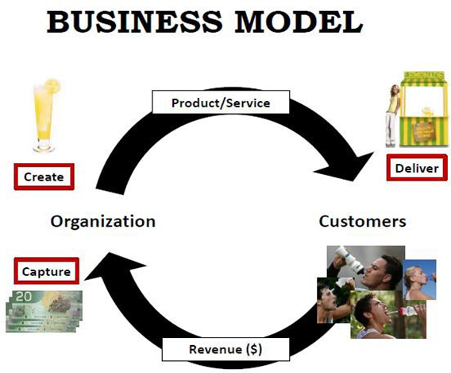
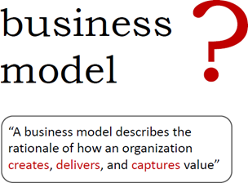

Slide 19
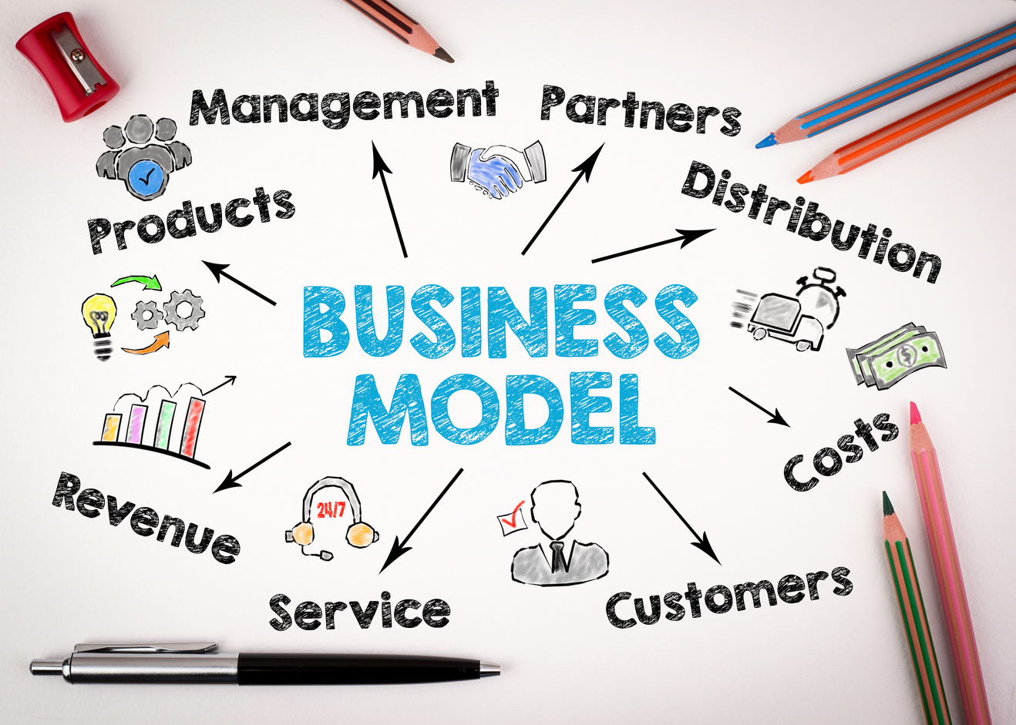
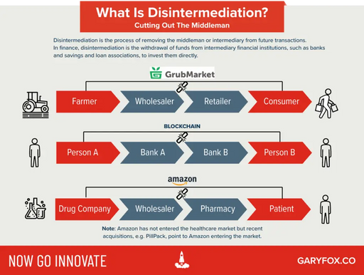

Business Model Examples To Inspire You
1. Freemium Business Model
2. Ecommerce Business Model
3. Razor and Blade Business Model
4. Reverse Razor and Blade
5. Hidden Revenue Model
6. Subscription Business Model
6. Cash Machine Business Model
7. Franchise Business Model
8. Affiliate Marketing Model
9. Agency Business Model
10. Disintermediation
11. Reverse Innovation Business Model
12. Solution Providers
13. Auction Business Model
14. Peer-to-Peer
15. Unbundling Business Model
16. Crowdfunding
16. Experience Selling
17. Ingredient Branding Model
18. Aggregation
19. Layer Player
20. License Business Model
21. Mass Customization
22. Pay Per Use
23. Shop In Shop
24. Direct To Consumer (D2C)
25. Target The Poor
Sources: https://www.garyfox.co/business-model-examples/

Slide 20


Slide 21
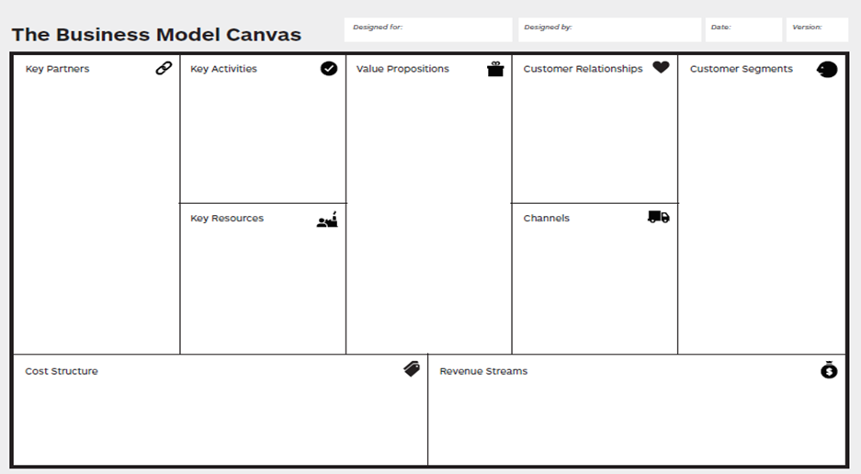

Slide 22
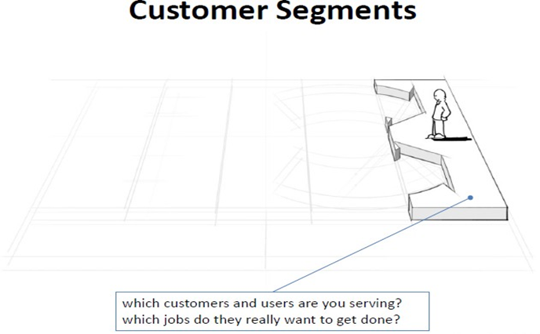

1

Slide 23
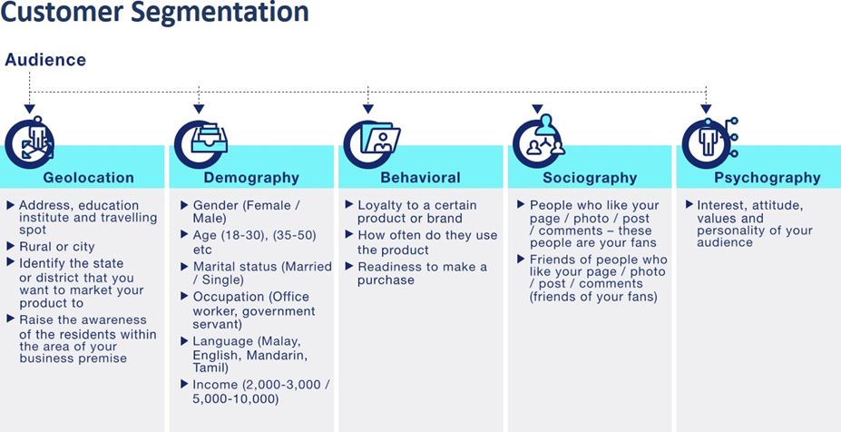

Slide 24
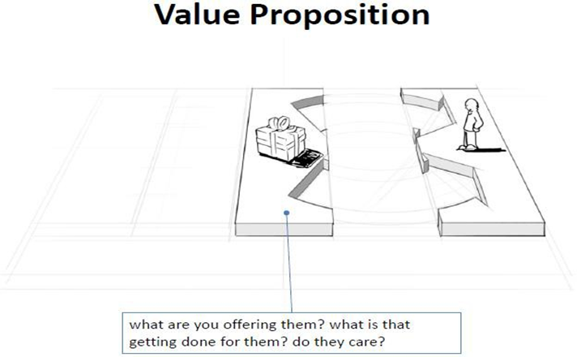
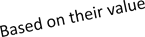

2

Slide 25
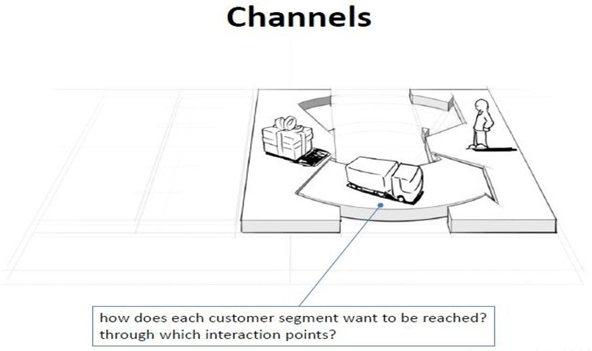

3

Slide 26
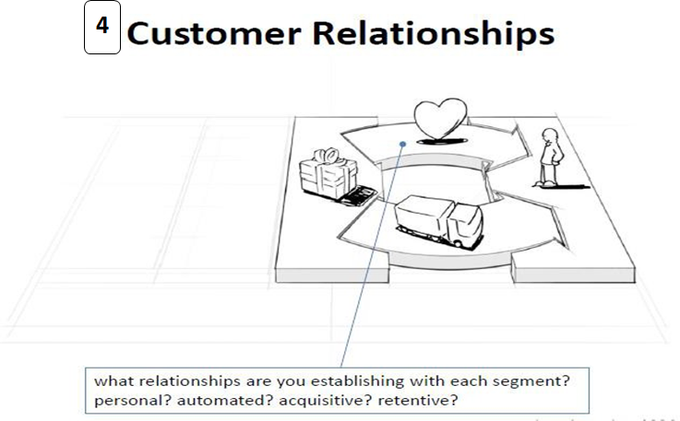


Slide 27
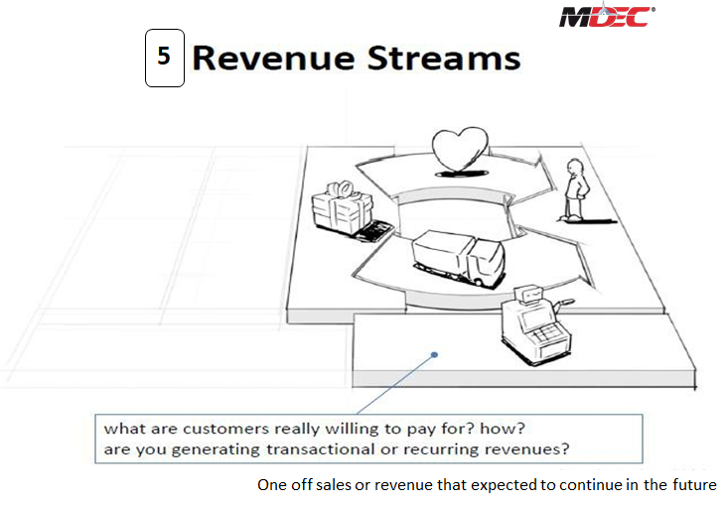


Slide 28
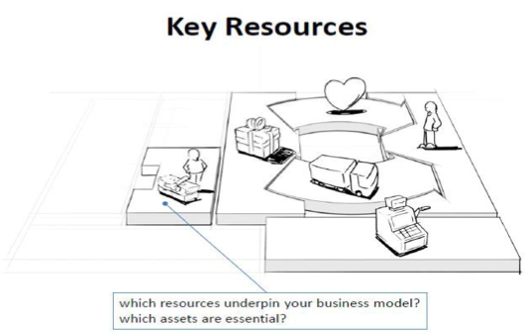

6

Slide 29
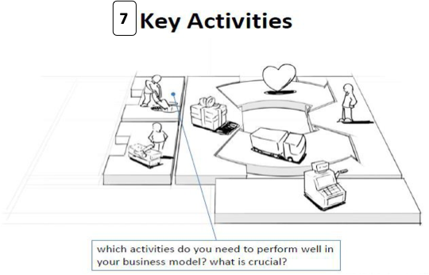


Slide 30
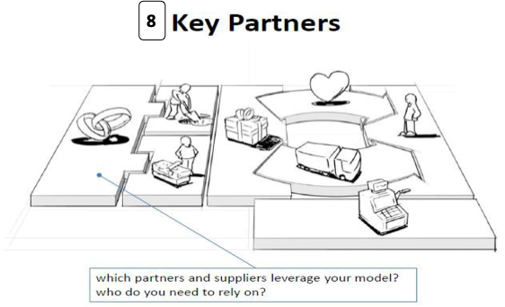


Slide 31
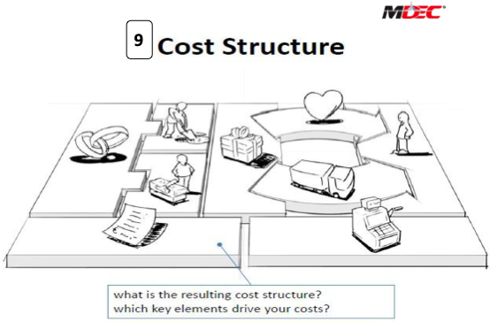


Slide 32

















The End
Thank You

